Slide 1
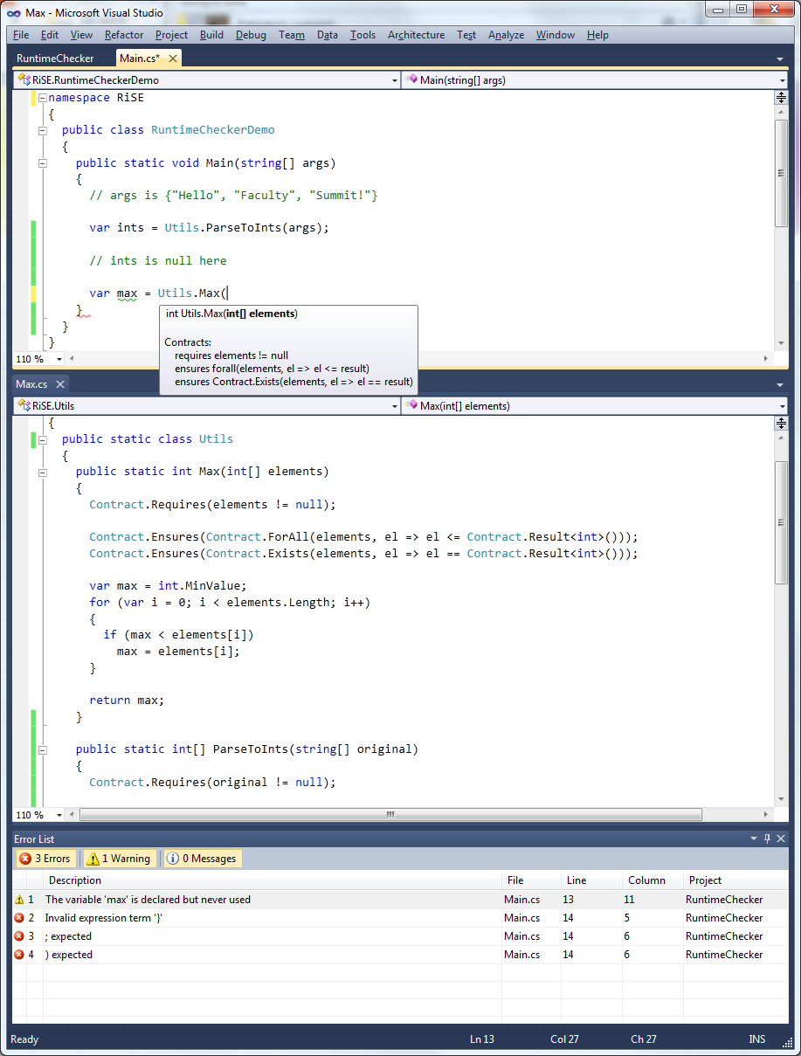
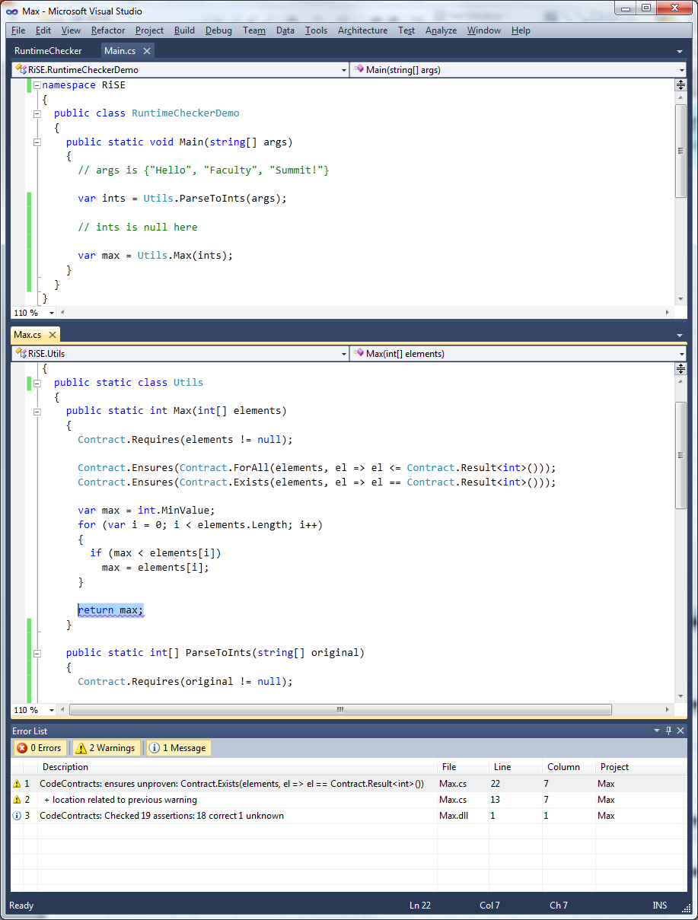
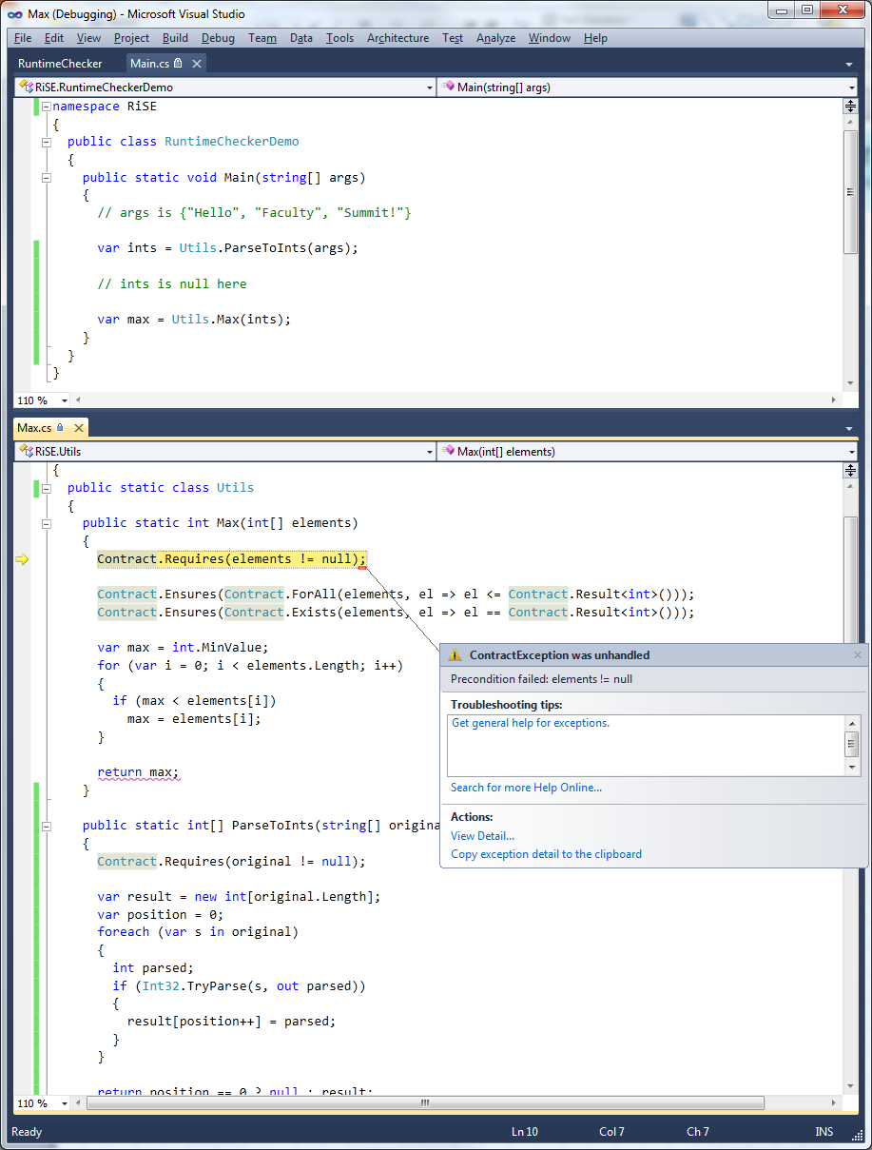
CodeContracts
http://research.microsoft.com/en-us/projects/contracts/
Enriched
IDE
Specify code with code
Preconditions
Postconditions
Object Invariants
In any .NET language!
API in .NET v4
Static
Verification
Runtime
Checking
Download the tools today!
Or try online at www.rise4fun.com

